Slide 1
Contract monthly claim system presented by: MOlemo

Slide 2
System overview
- Automated claims platform for educational institutions
- Streamlines lecturer payment claims and approval workflows
Role based access for Lecturers, coordinators, and hr.
Built with modern ASP.NET core MVC architecture
The application implements secure authentication and validation process

Slide 3
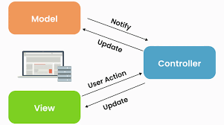
Technical foundation
Front-end:
-ASP.NET Core MVC
Razor Views with Bootstrap
JQuery for client-side validation
Responsive UI design
Backend:
C# with ASP.NET Core
Entity Framework Core
Dependency Injection
Repository Pattern
Security:
- Secure Data Validation
ASP.NET Identity
Role-Based Authorization

Slide 4
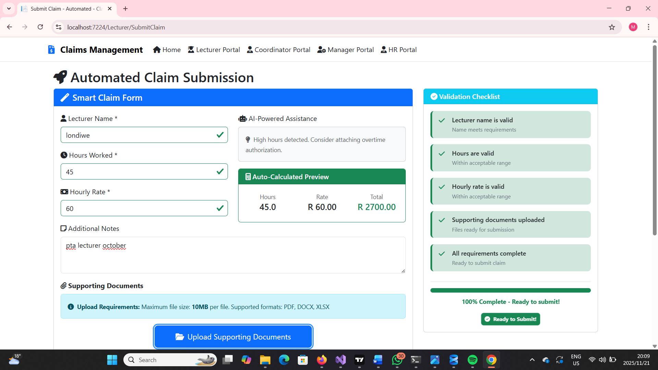
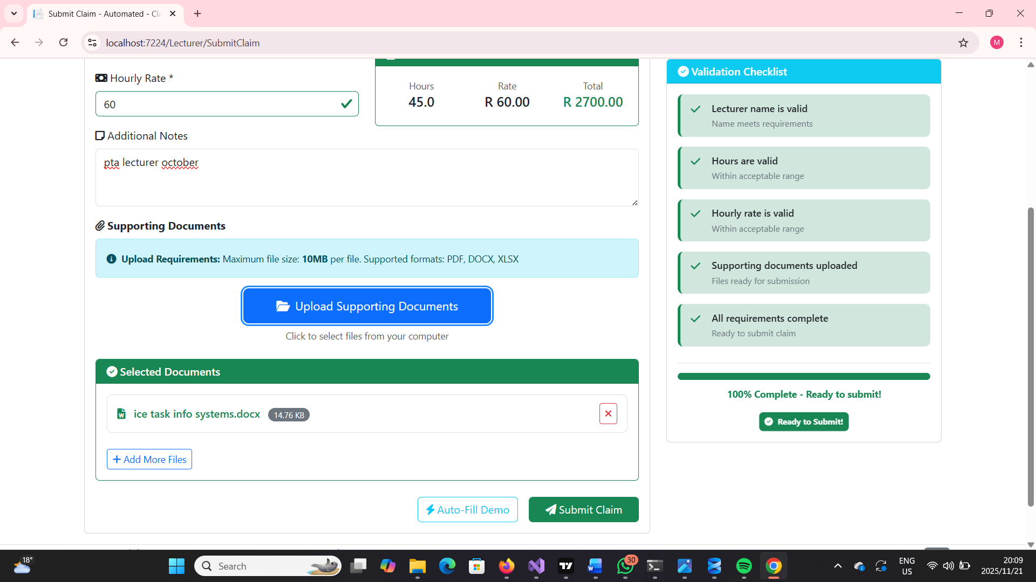
Lecturer Experience
Automated Claim Submission:
Intuative claim form with auto-calculation
-Real-time total amount computation
Submission history tracking
Validation & Security
- User-Specific data isolation

Slide 5
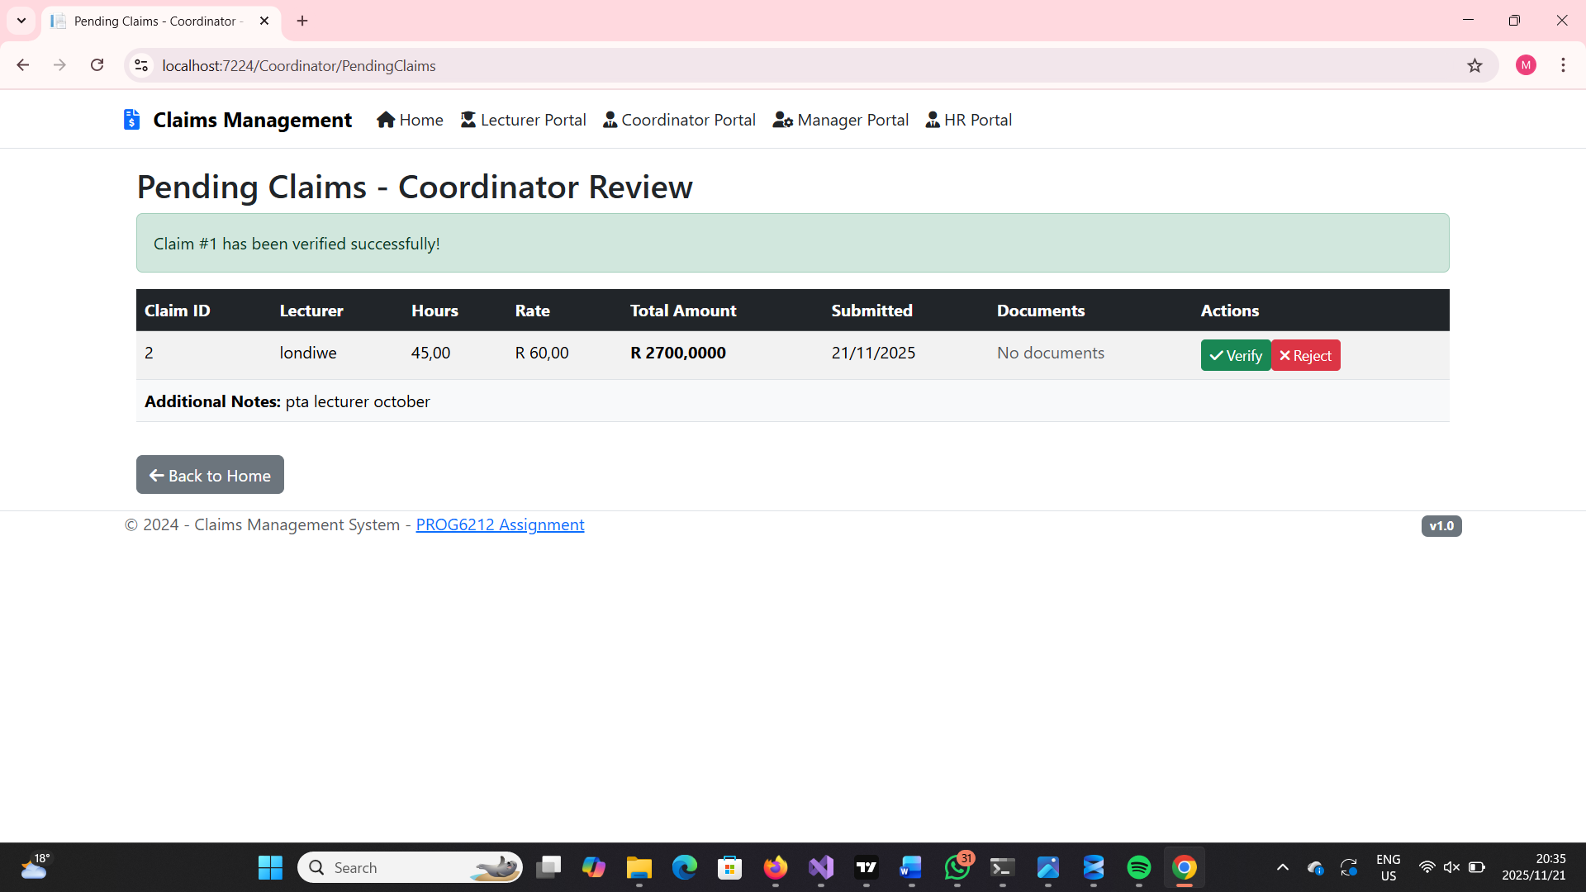
Coordinator experience
Automated verification
Centralized claim review portal
Status tracking and filtering
Bulk approval/rejection capabilities
Workflow Management
Multi-level approval routing
Audit trail maintenance

Slide 6
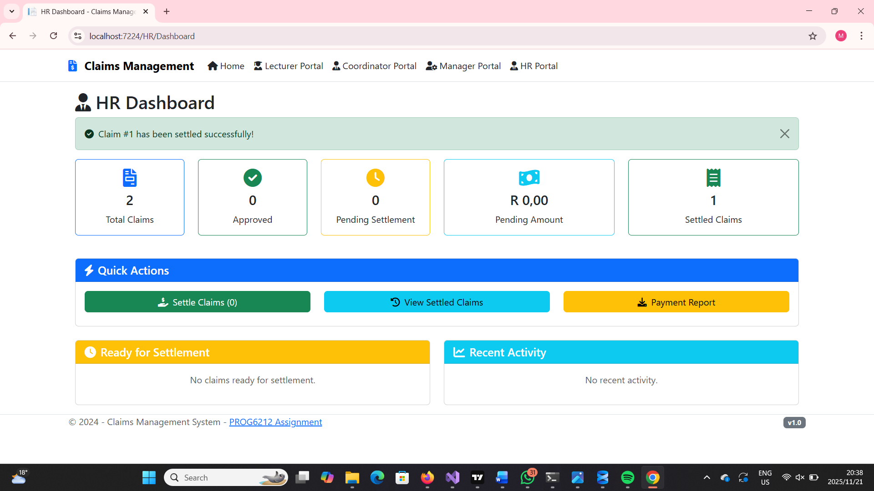
Human resources Portal
Advanced Processing:
-Payment Reference Tracking
Comprehensive Reporting
Analytics dashboard
Data Management :
- Lecturer information management
Payment history records
Store Login credentials

Slide 7
Automation
Calculation Engine:
Hours worked Validation
Automatic total amount calculation computation
Rate validation against policies
Workflow Automation
- Status progression automation
- Approval routing logic

Slide 8
Data architecture
Core Entities:
Users (Lecturers, Coordinator, hr)
Claims with status tracking
Settlements and payments
Audit logs
Historical data preservation

Slide 9
MODERN UI/UX DESign
Dashboard feature:
Quick action buttons
Real-time statistics
Role-specific overviews
Navigation:
Status color coding
Intuitive menu structure

Slide 10
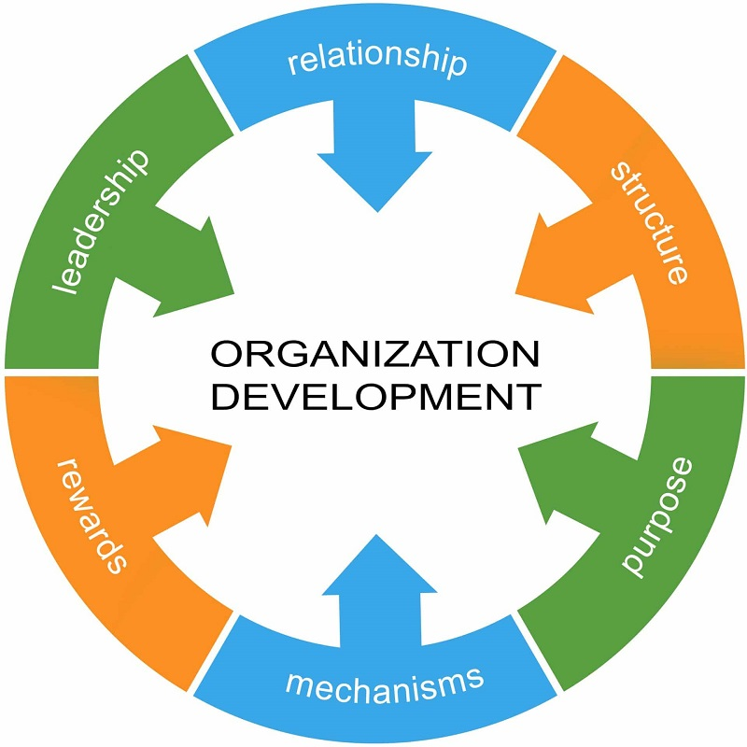
Organization benefits
Efficiency benefits:
- 70% reduction in processing time
- Centralized data management
- Automatic validation reduces errors
Cost Savings:
Faster payment processing
Less admintstrative work

Slide 11
Thank you

